Slide 1
Մաս 3
Մատրից
Notes:
You have to see it yourself

Slide 2

Notes:
Describe transformation

Slide 3
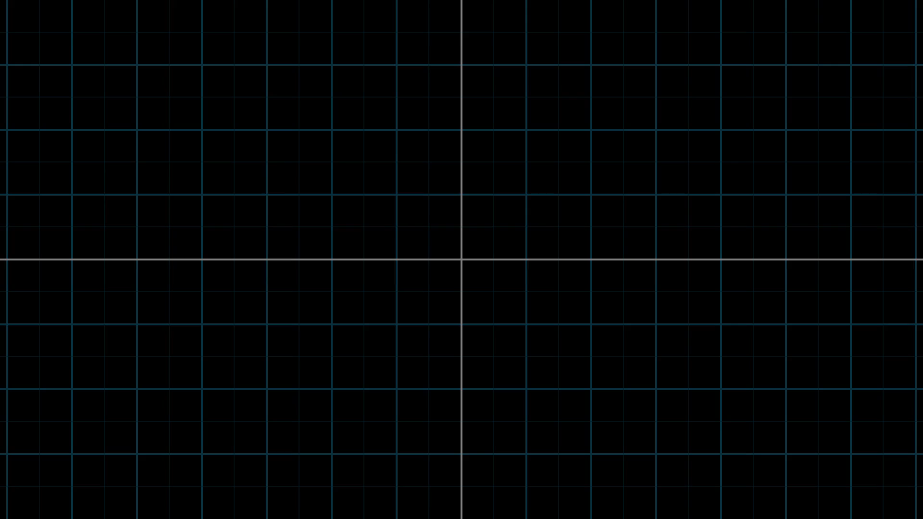
Notes:
Transform just one vector

Slide 4
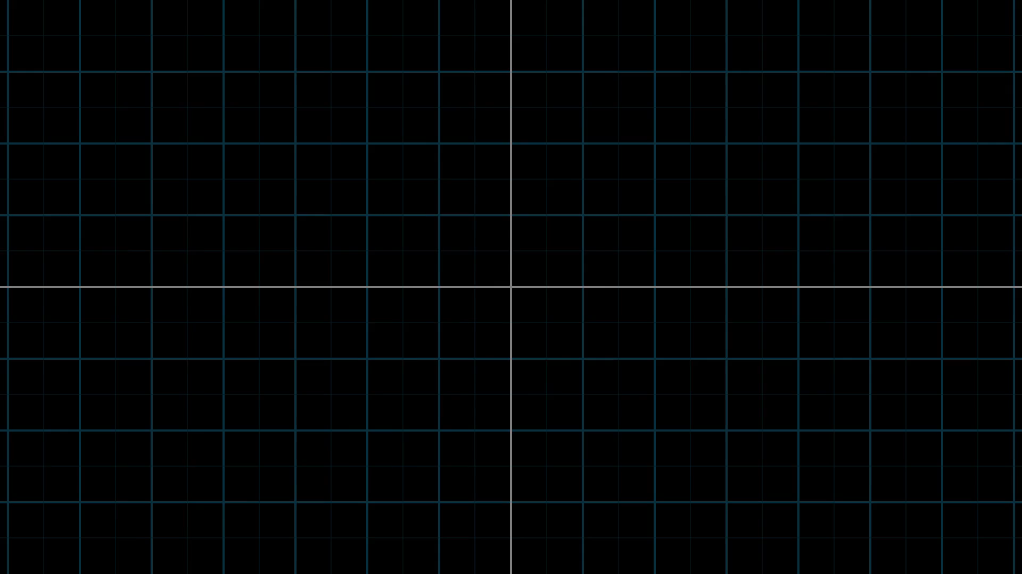
Notes:
c

Slide 5
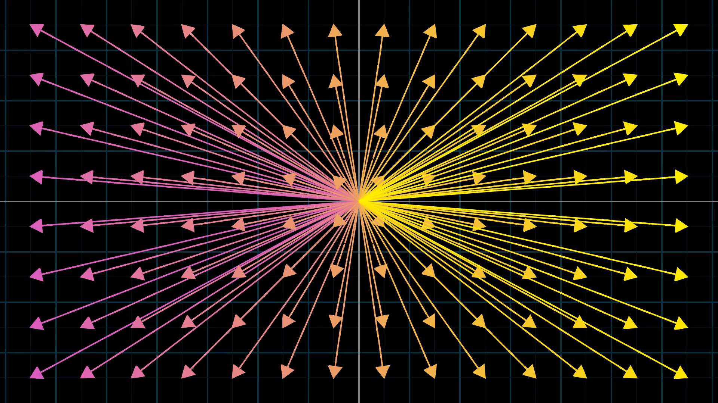
Notes:
Transform many vectors as points

Slide 6
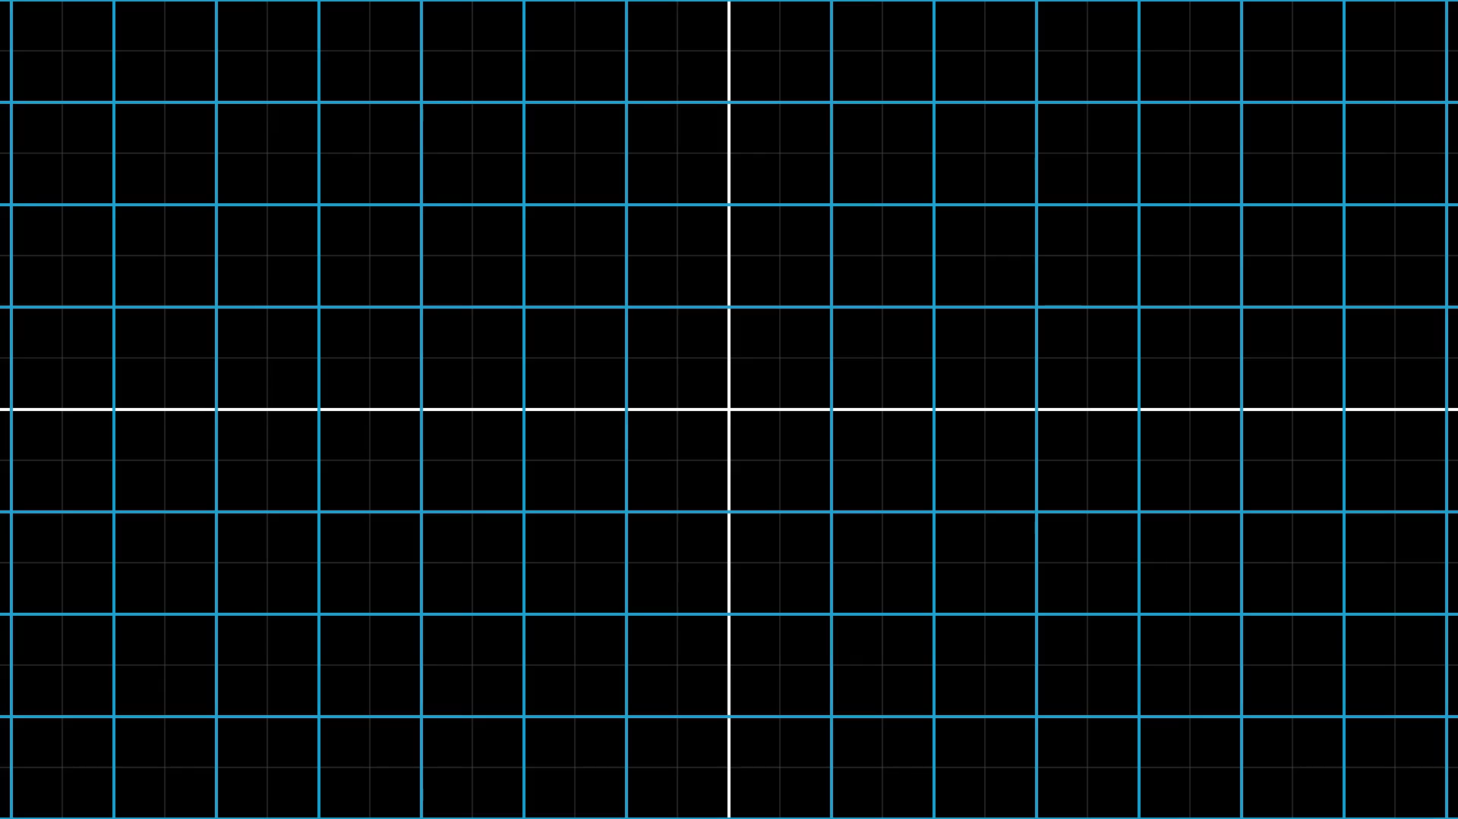
Notes:
Transform infinite grid

Slide 7
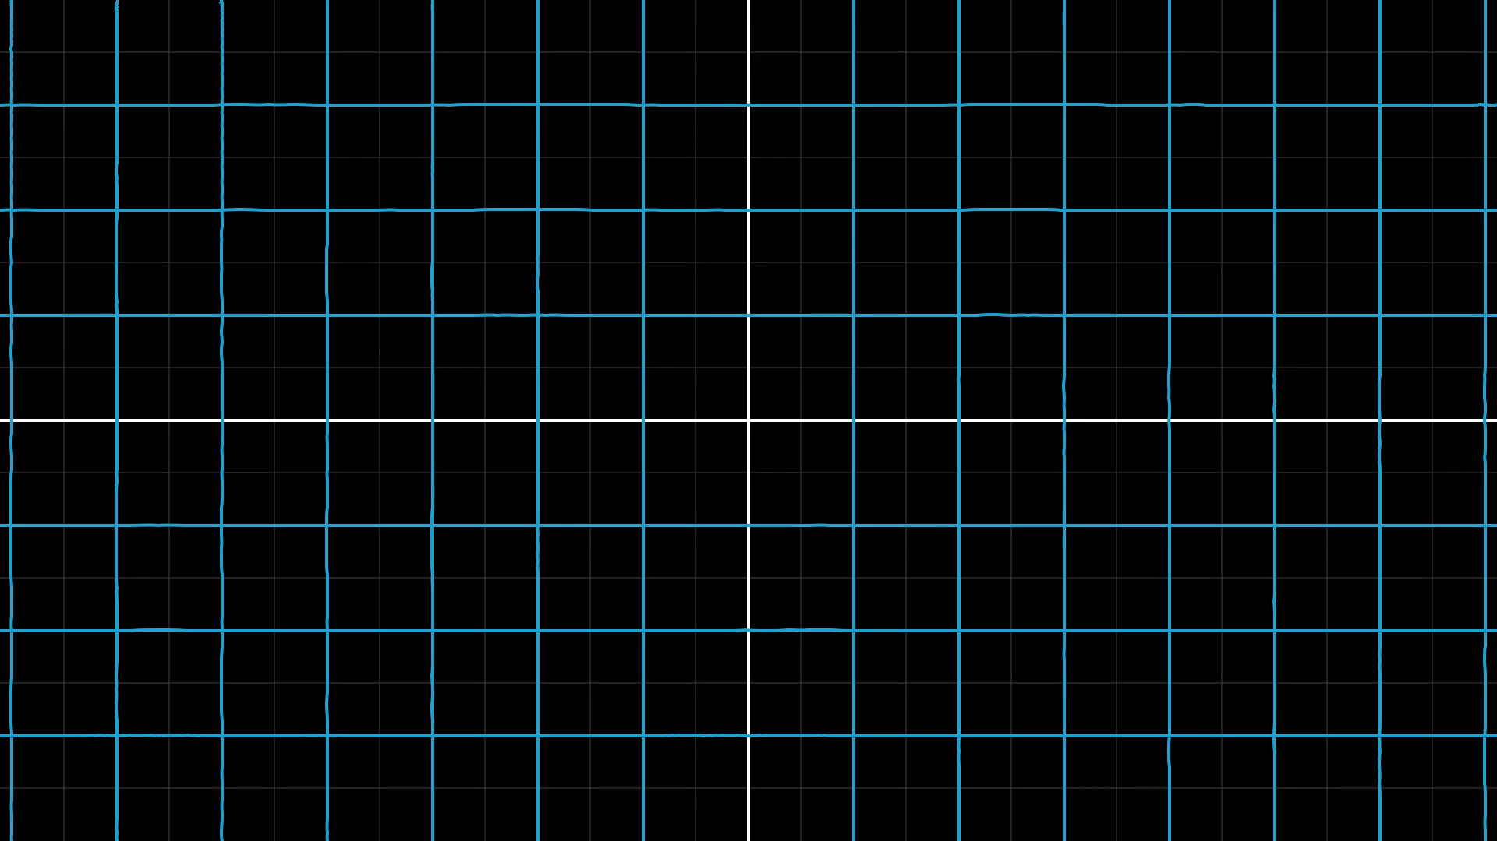
Notes:
Apply complex function

Slide 8
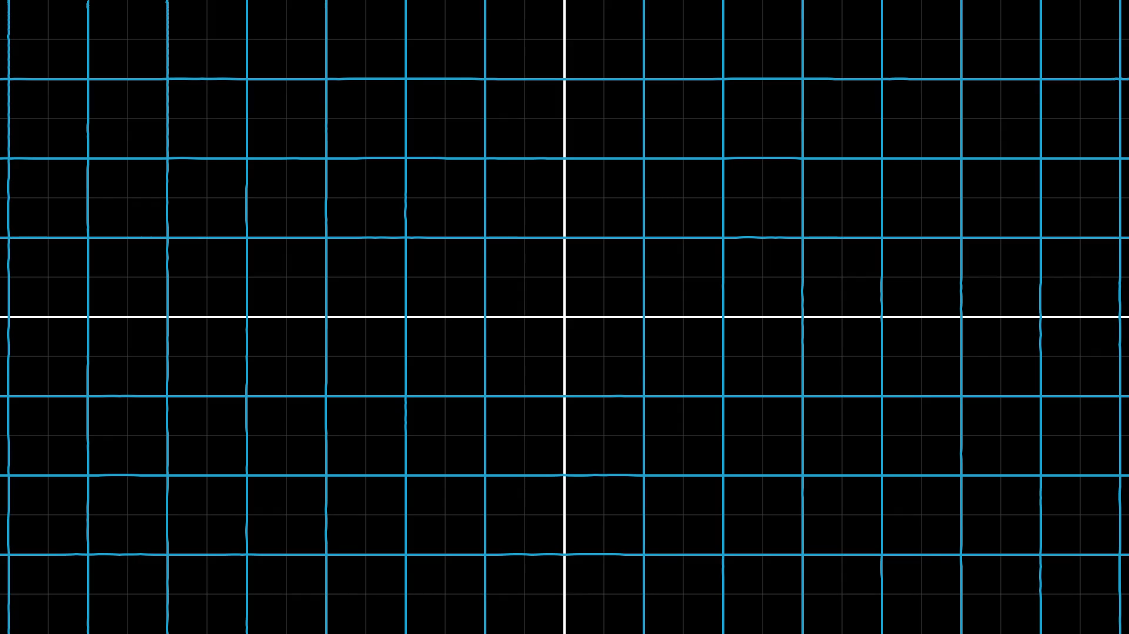
Notes:
Exponential transformation

Slide 9
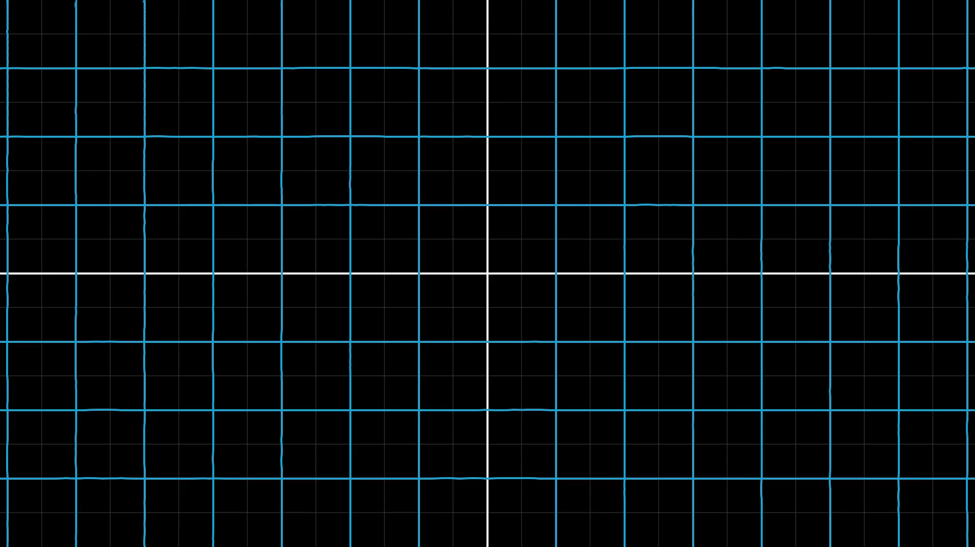
Notes:
Crazy transformation

Slide 10
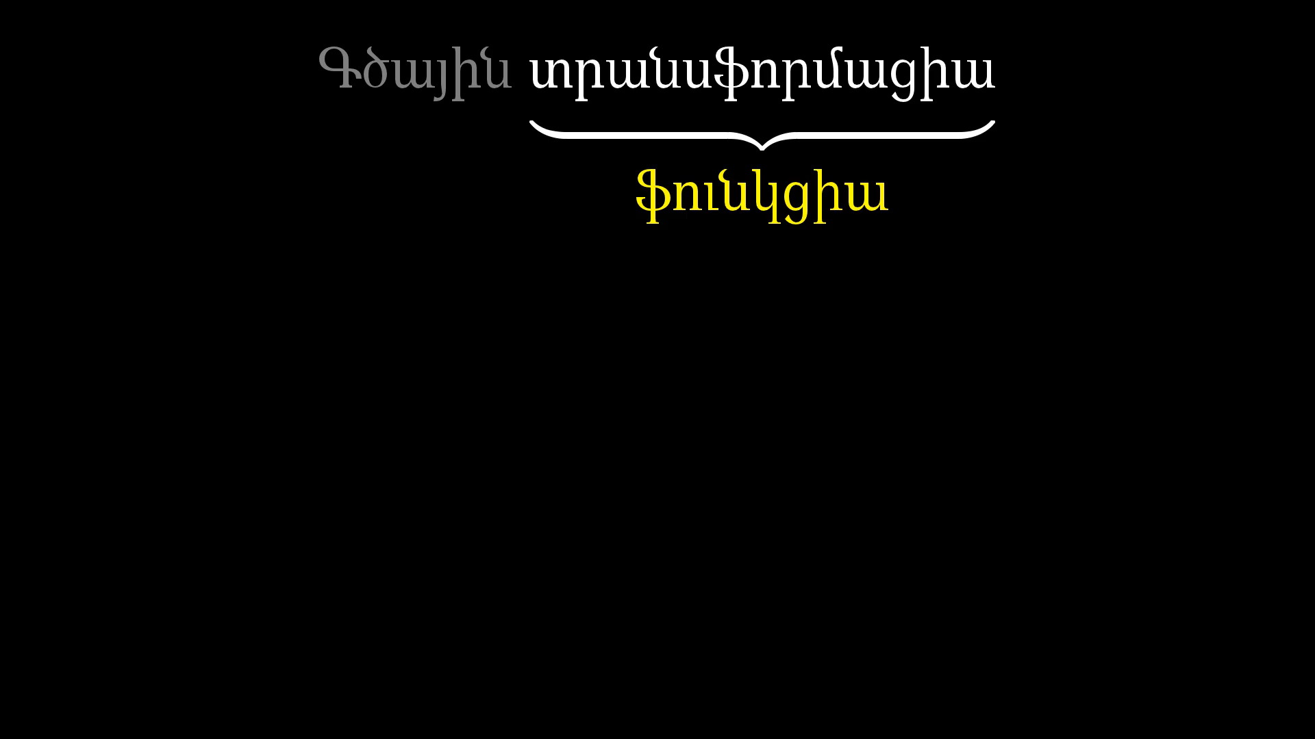
Notes:
Look to word linear

Slide 11
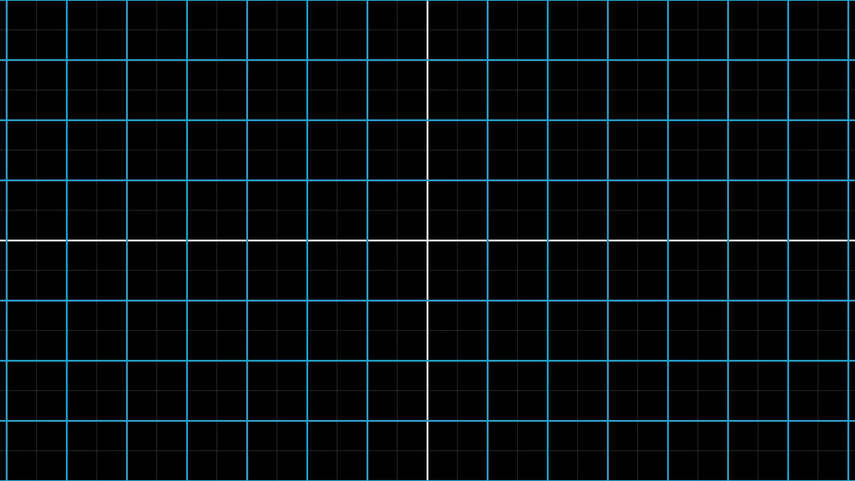
Notes:
Introduce linear transformation

Slide 12
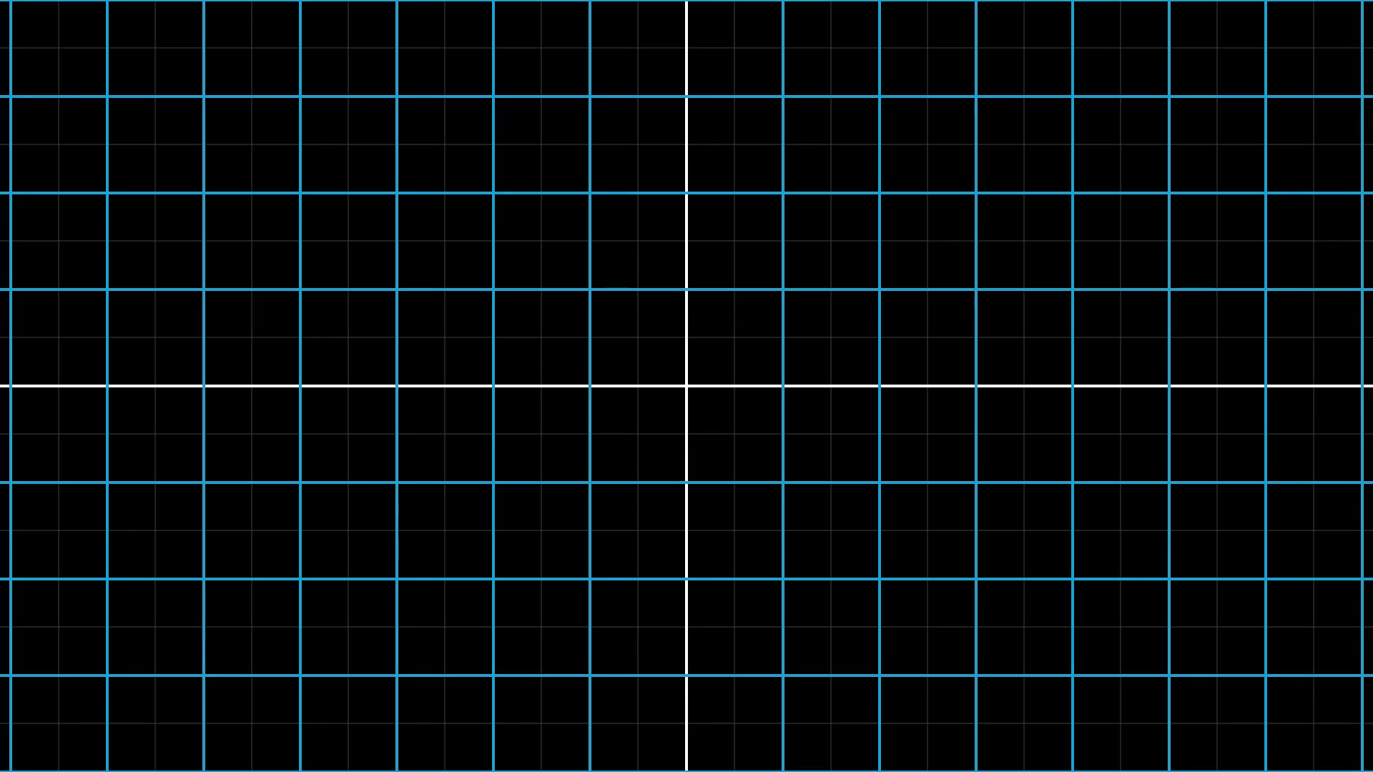
Notes:
Nonlinear transformation example

Slide 13
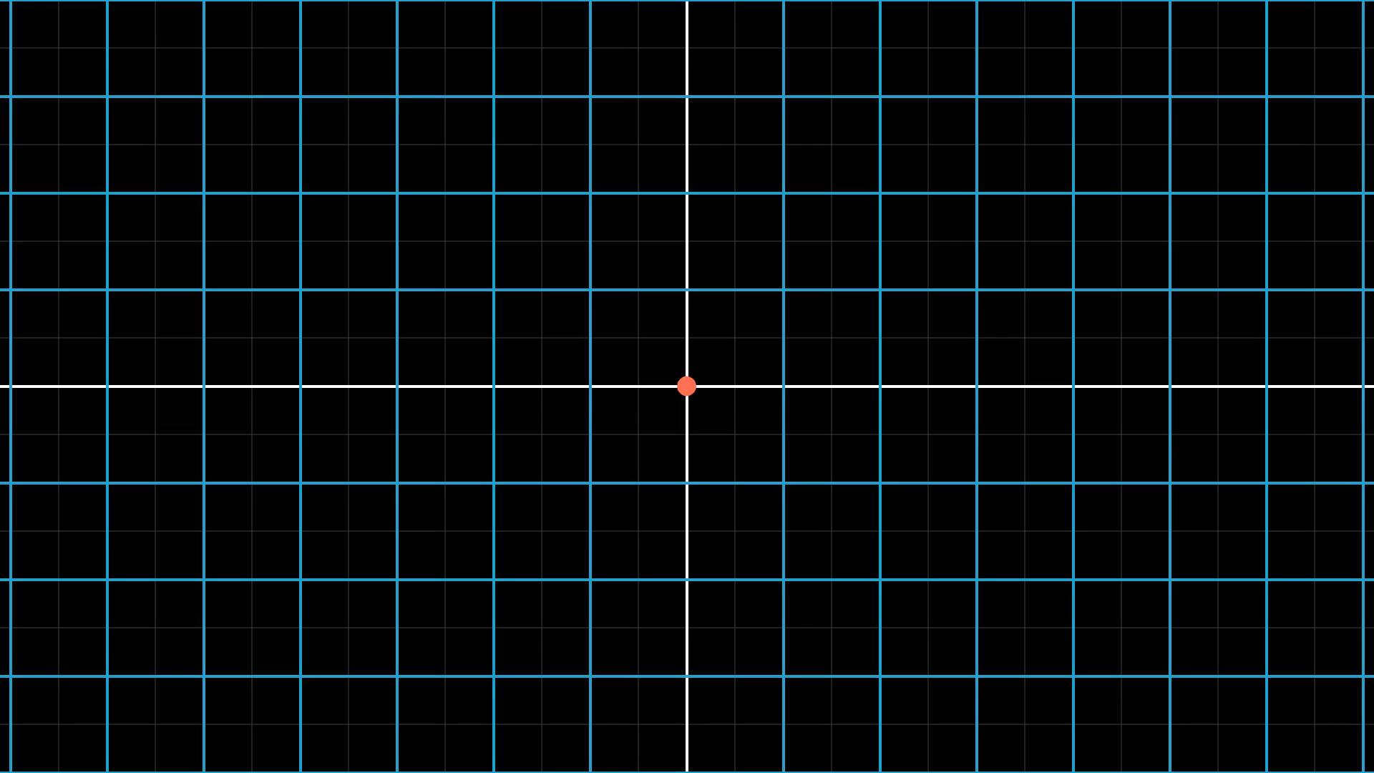
Notes:
Origin moves example

Slide 14
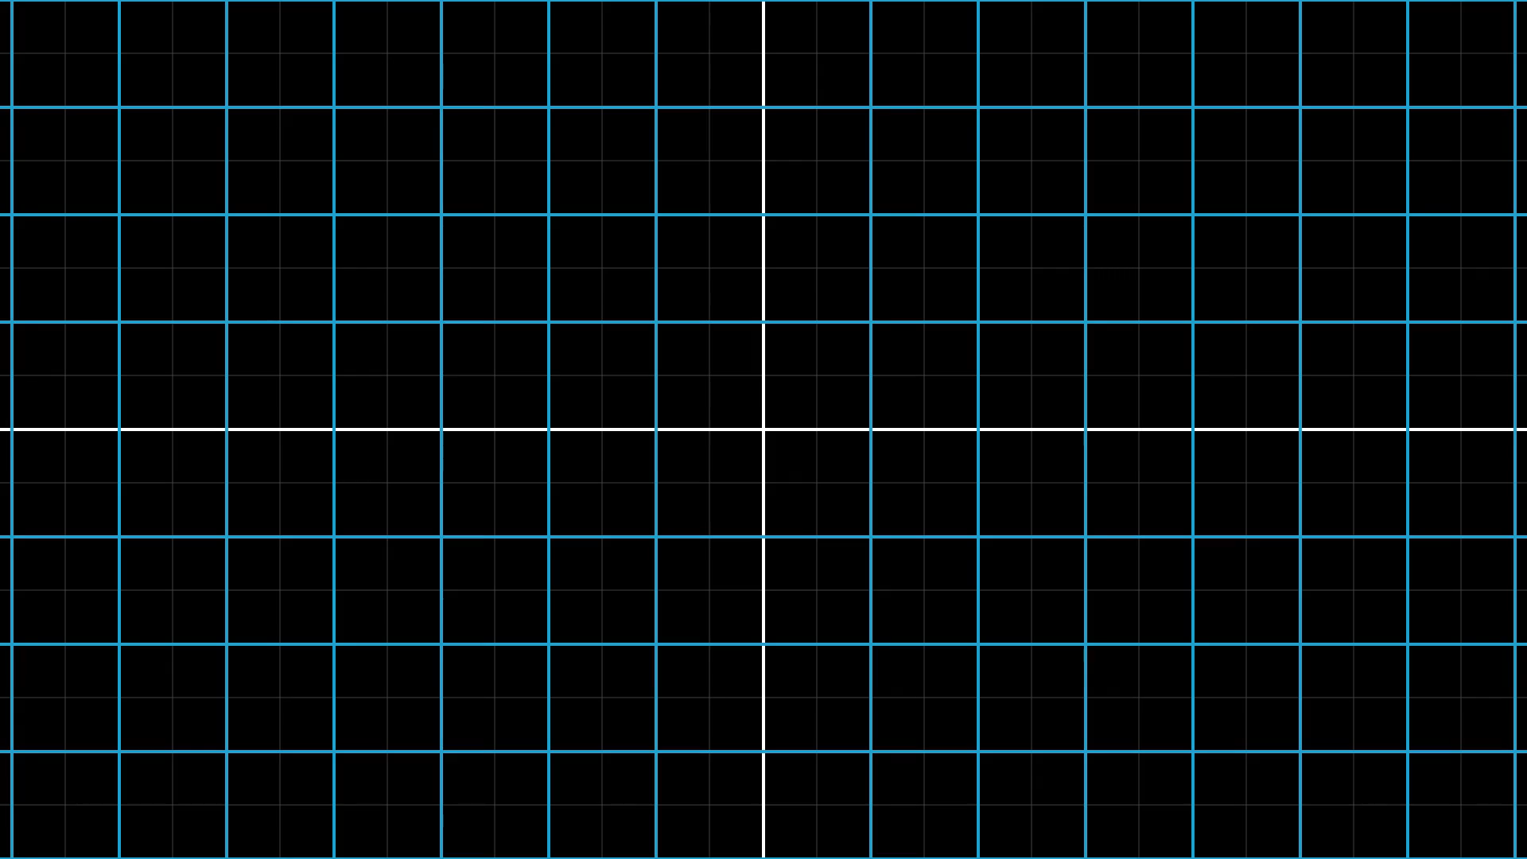
Notes:
Sneaky nonlinear transformation

Slide 15
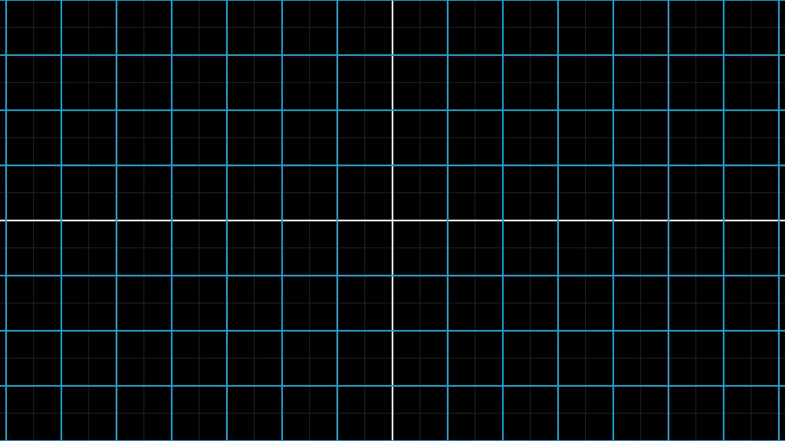
Notes:
Explanation of sneaky nonlinear transformation

Slide 16
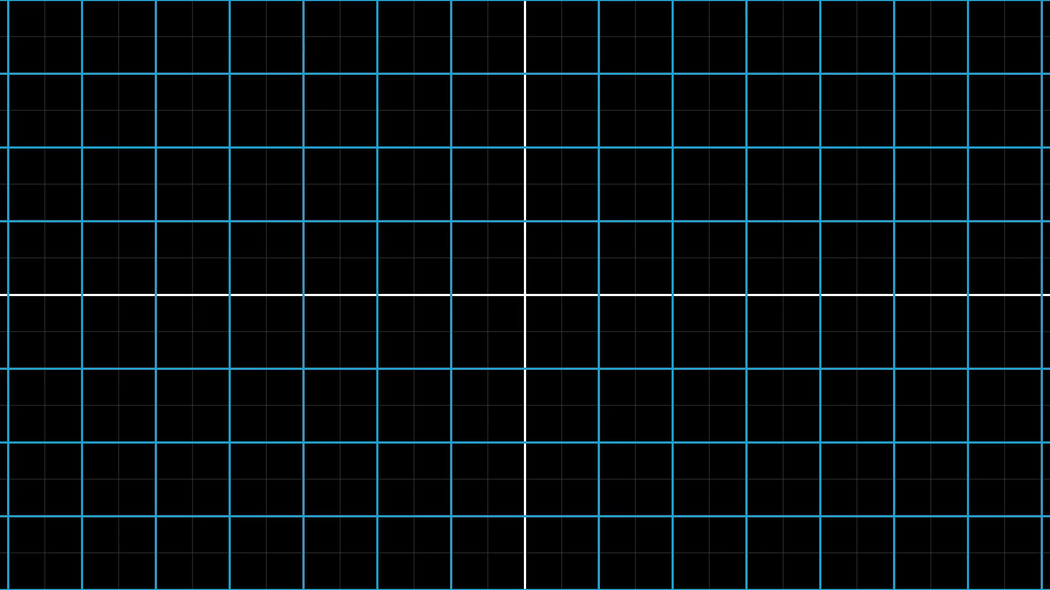
Notes:
Grid line properties

Slide 17
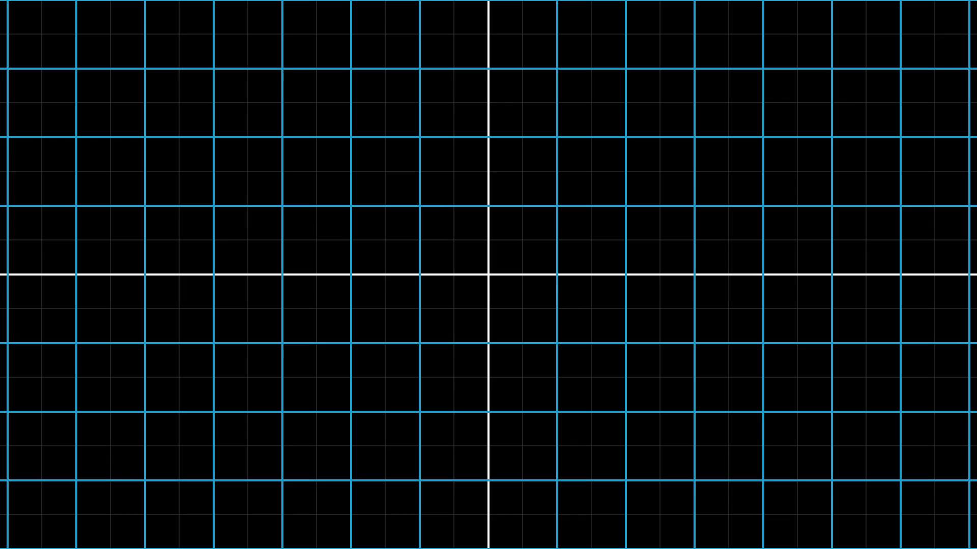
Notes:
roation

Slide 18
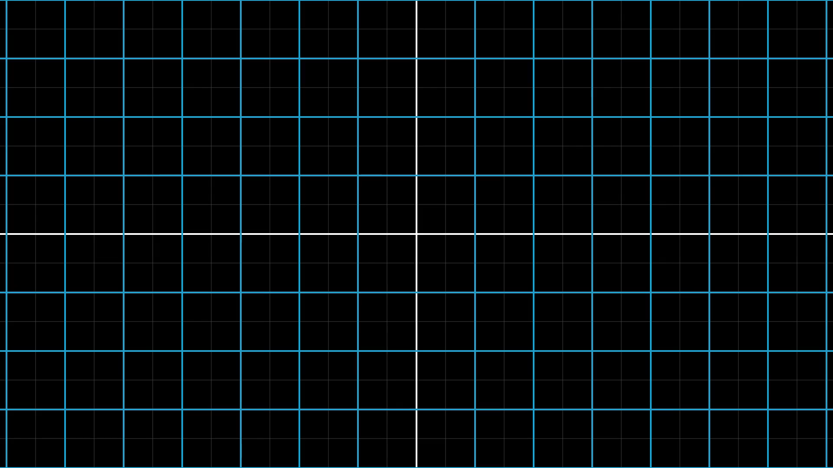
Notes:
Flipping linear transformation
(change)

Slide 19
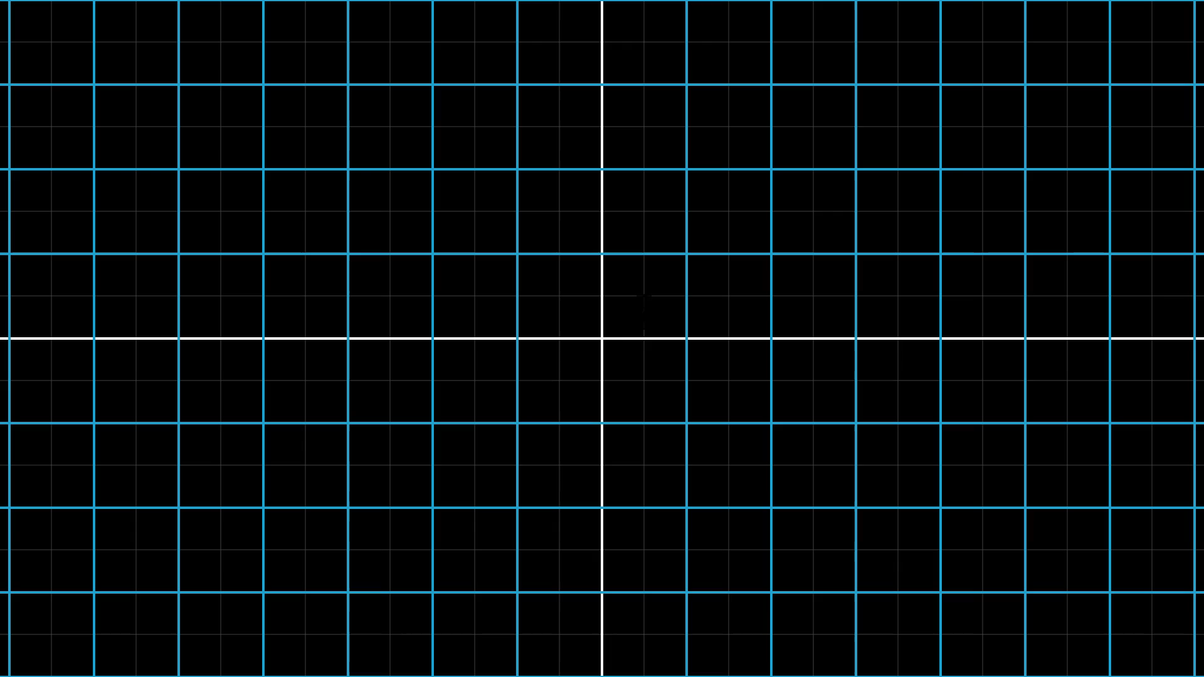
Notes:
Follow I and J

Slide 20
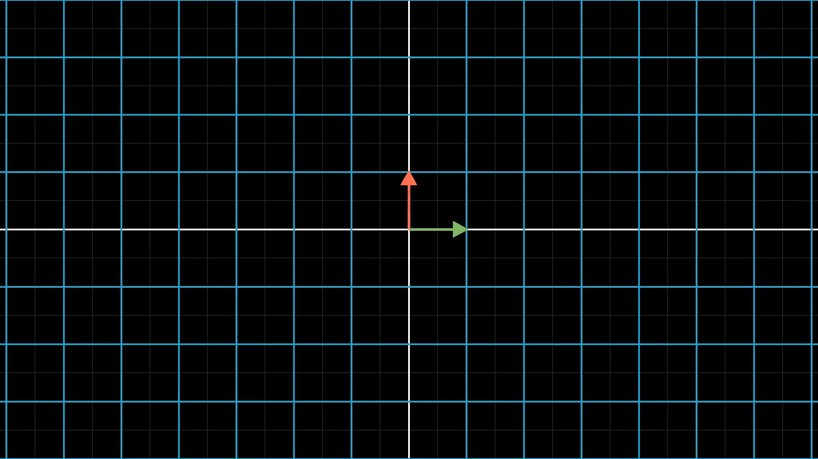
Notes:
Track basis vectors

Slide 21
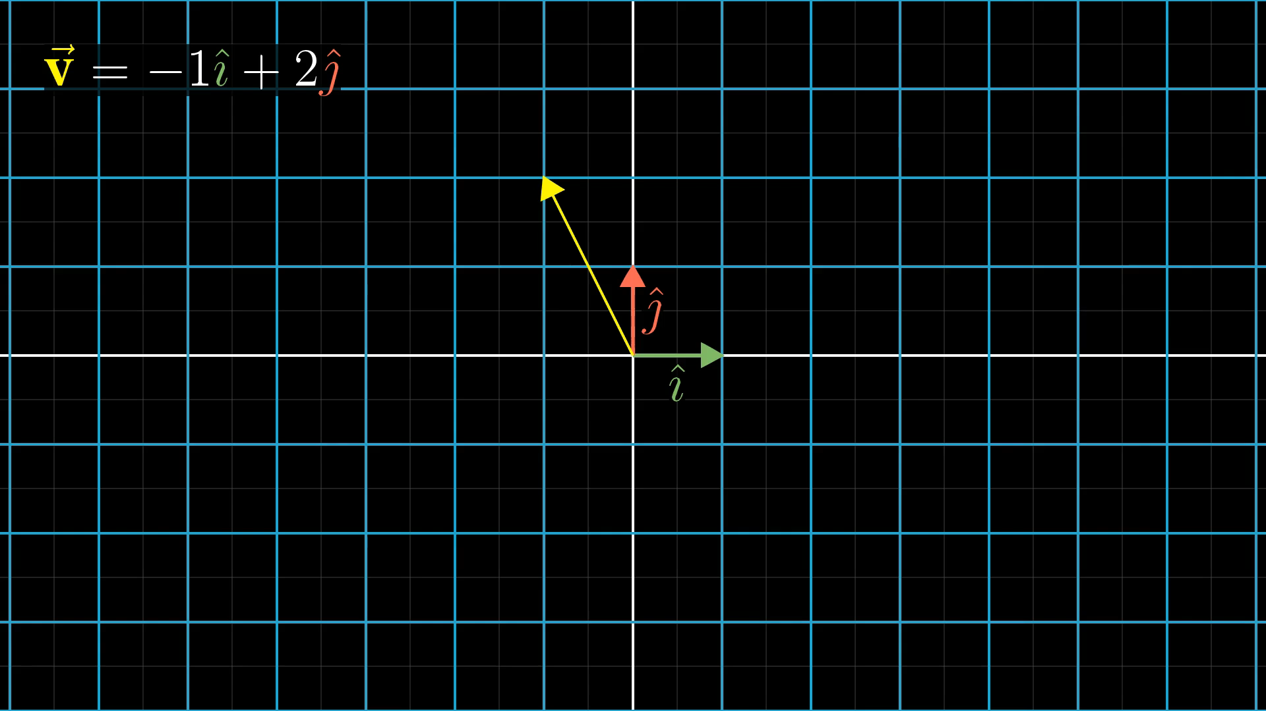
Notes:
Track basis vectors

Slide 22
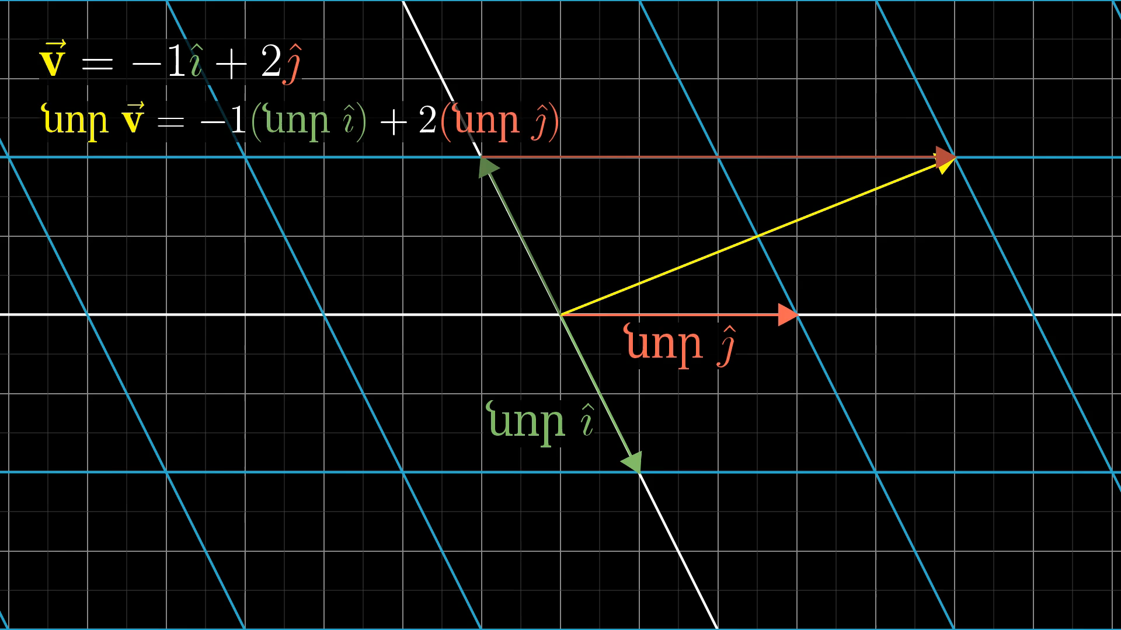
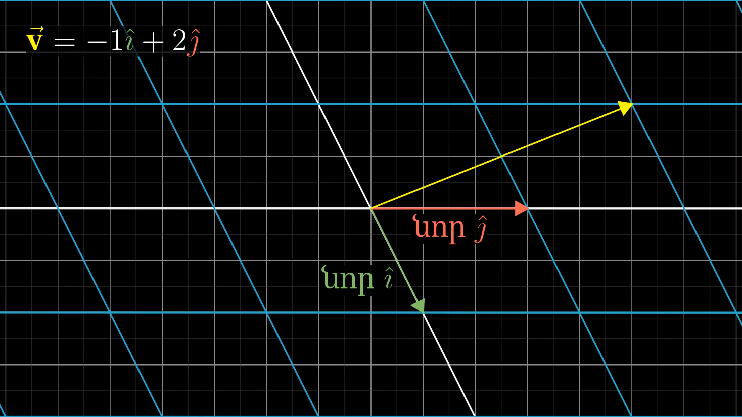
Notes:
calculations

Slide 23
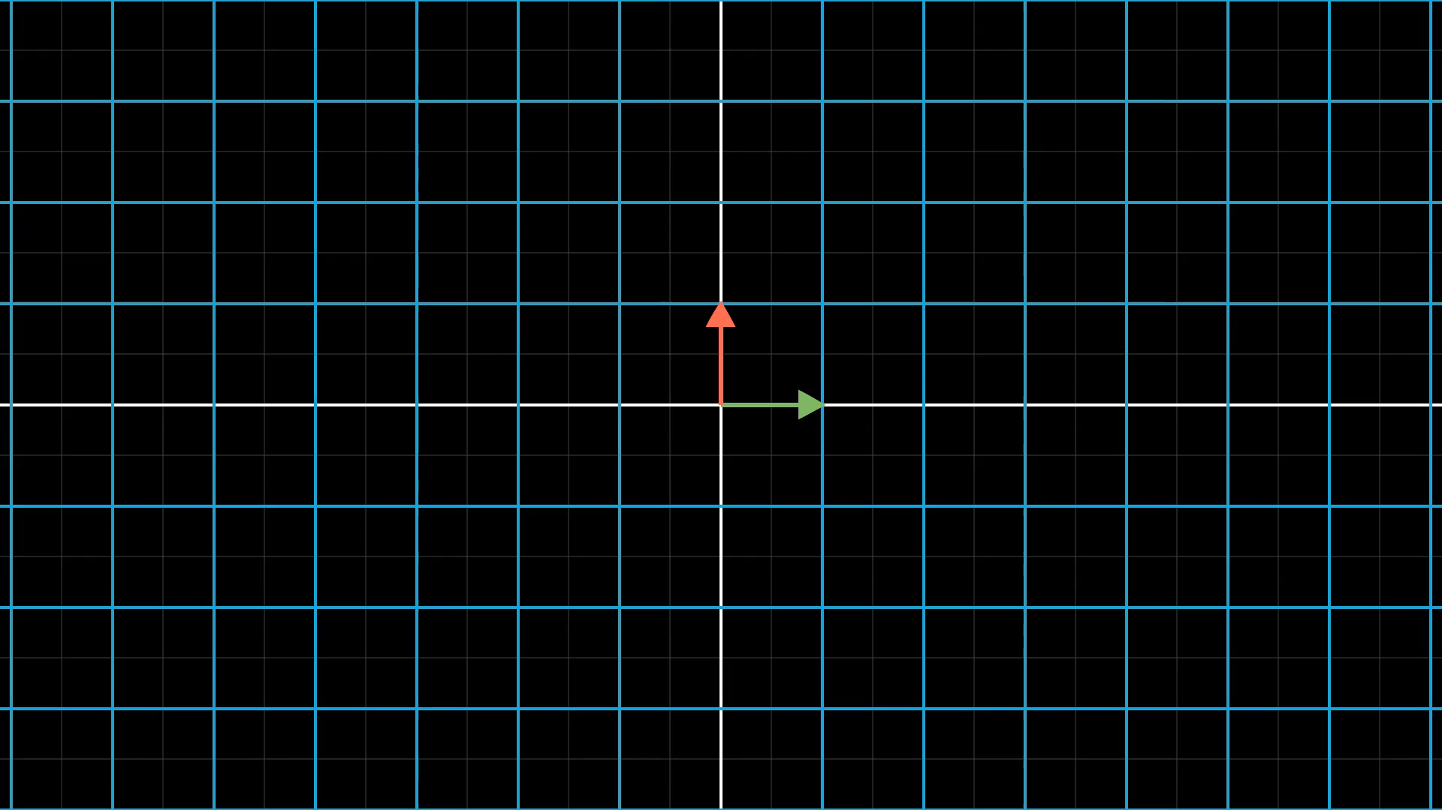
Notes:
Watching many vectors move

Slide 24
Հիմա առանց նայելու

Slide 25
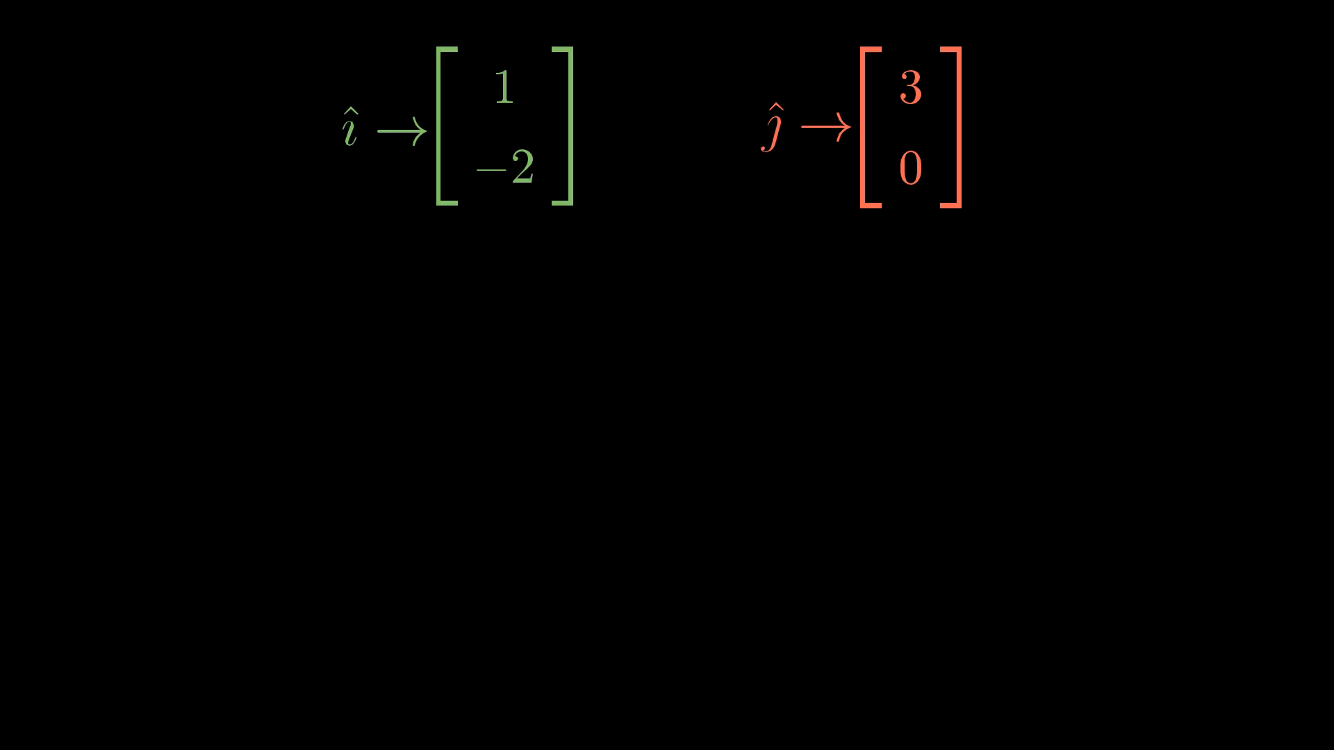
Notes:
Deduce result

Slide 26
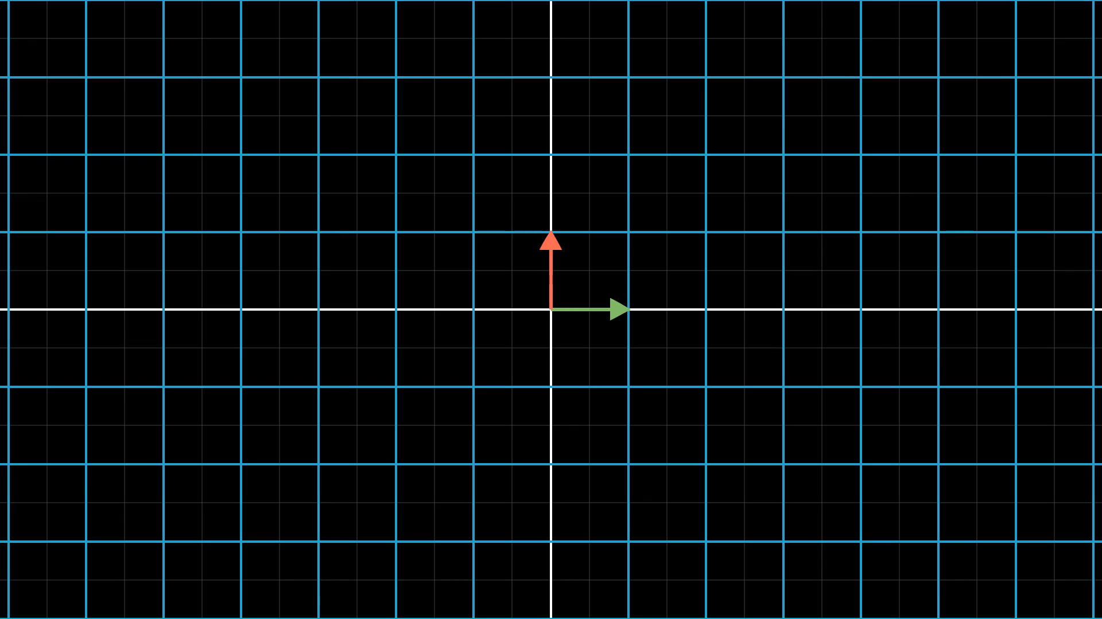
Notes:
Introduce matrix

Slide 27
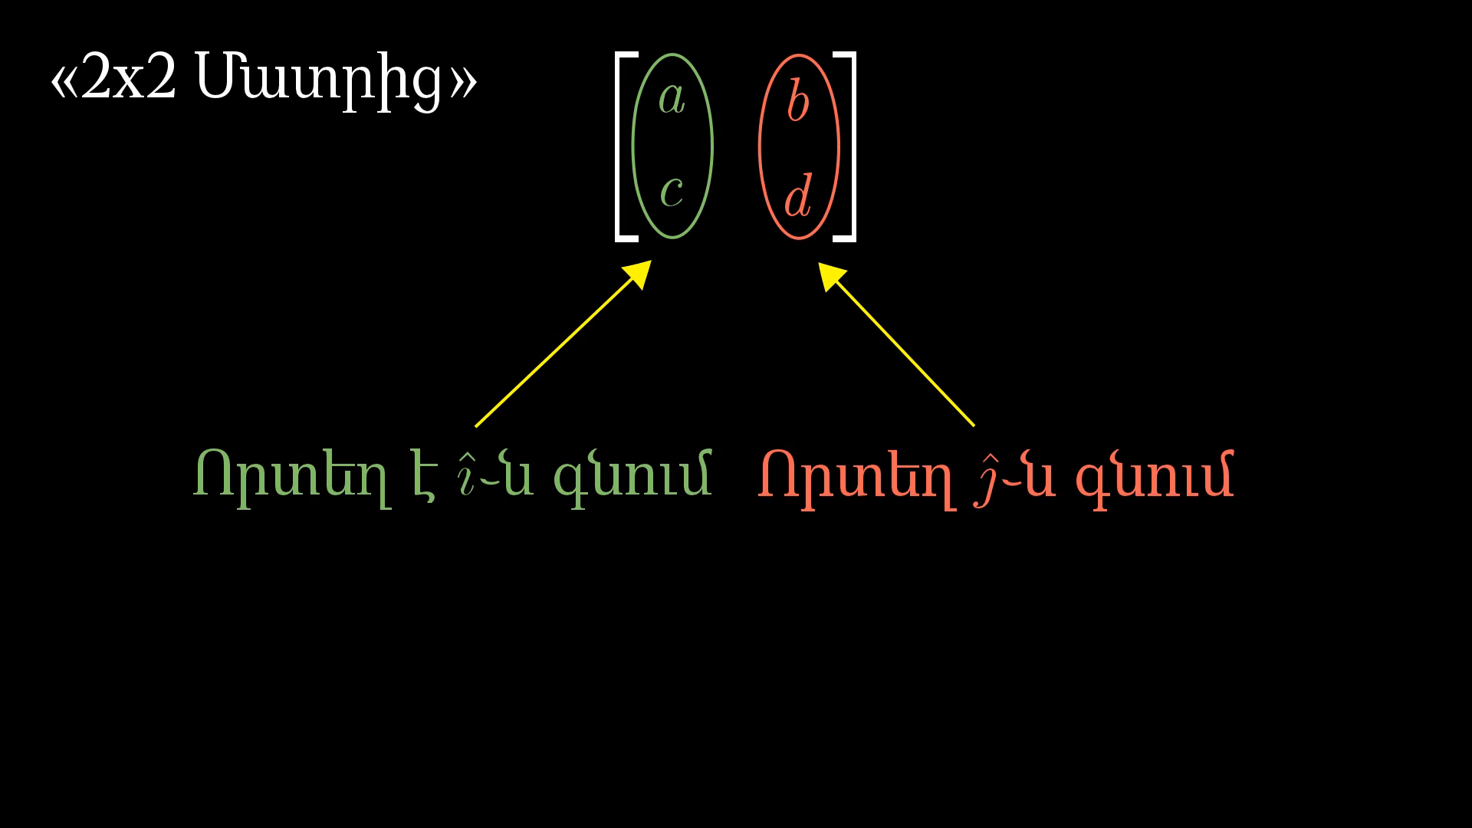
Notes:
Matrix vector multiplication

Slide 28
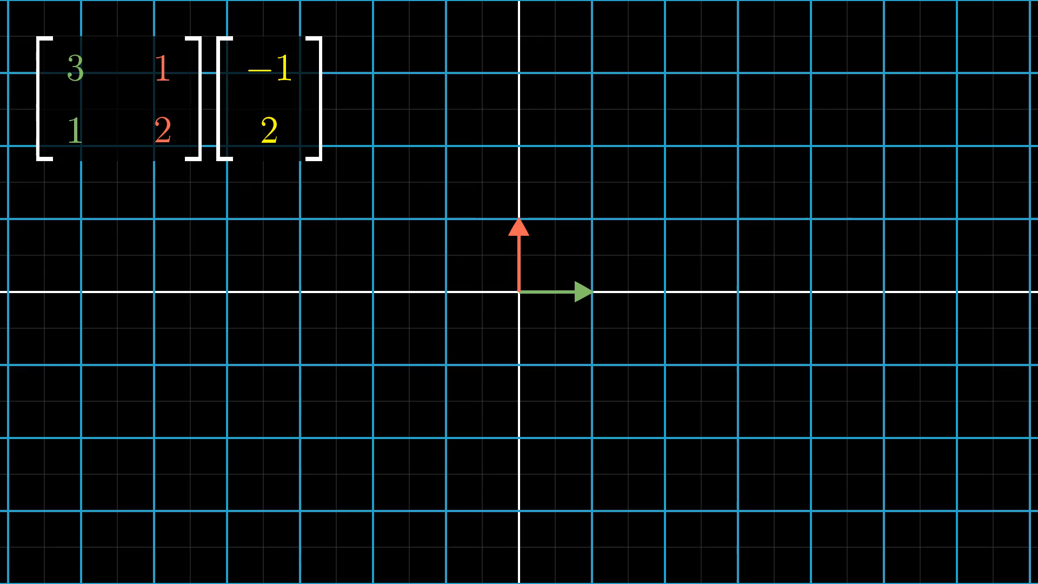
Notes:
Now visually

Slide 29
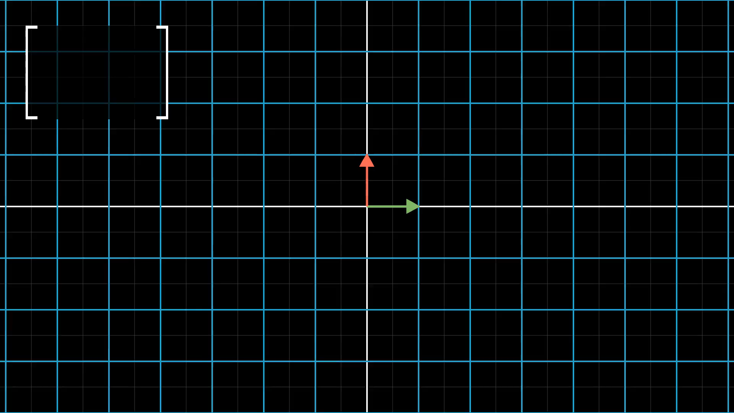
Notes:
Describe rotation

Slide 30
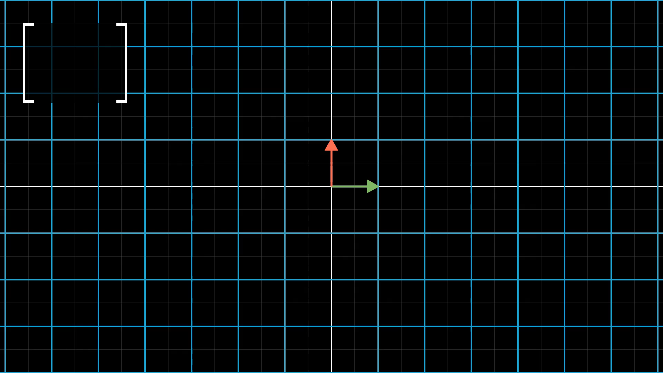
Notes:
Describe shear

Slide 31
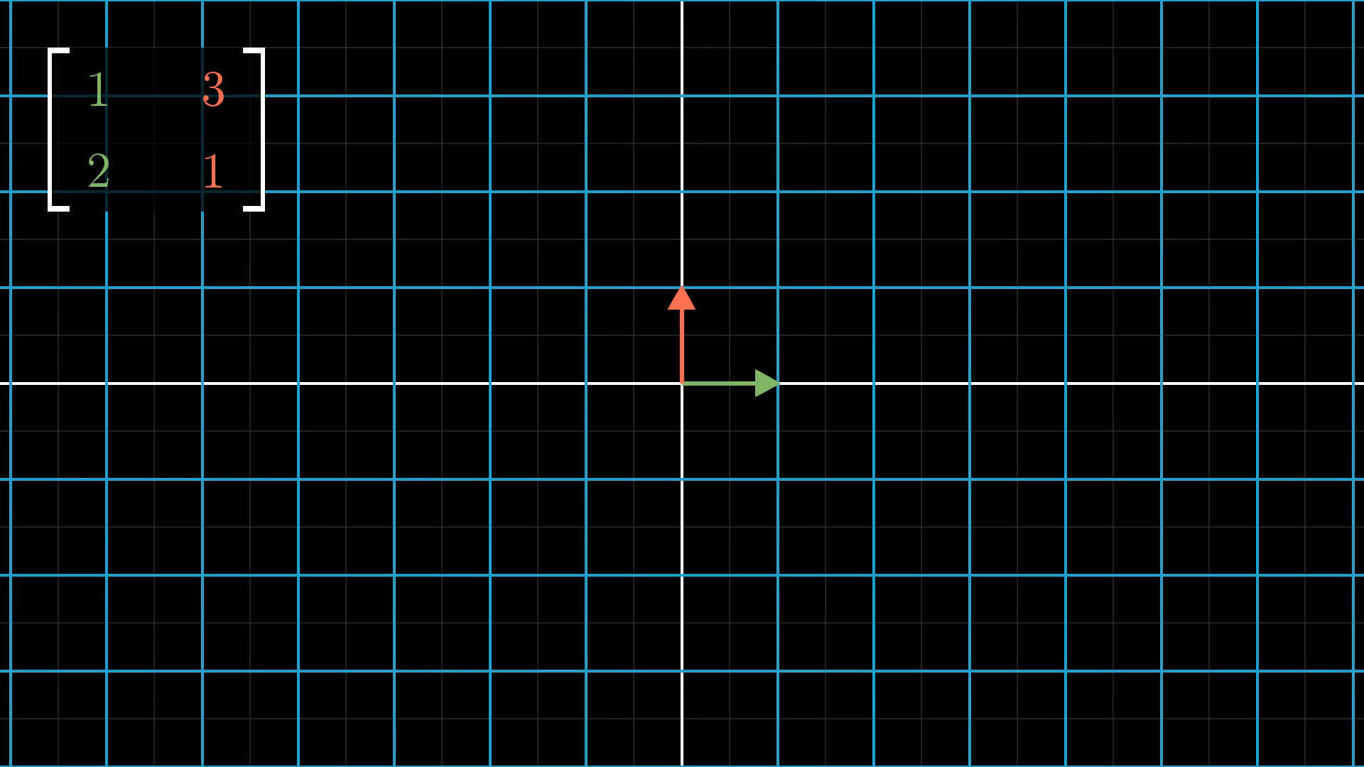
Notes:
Deduce transformation from matrix

Slide 32
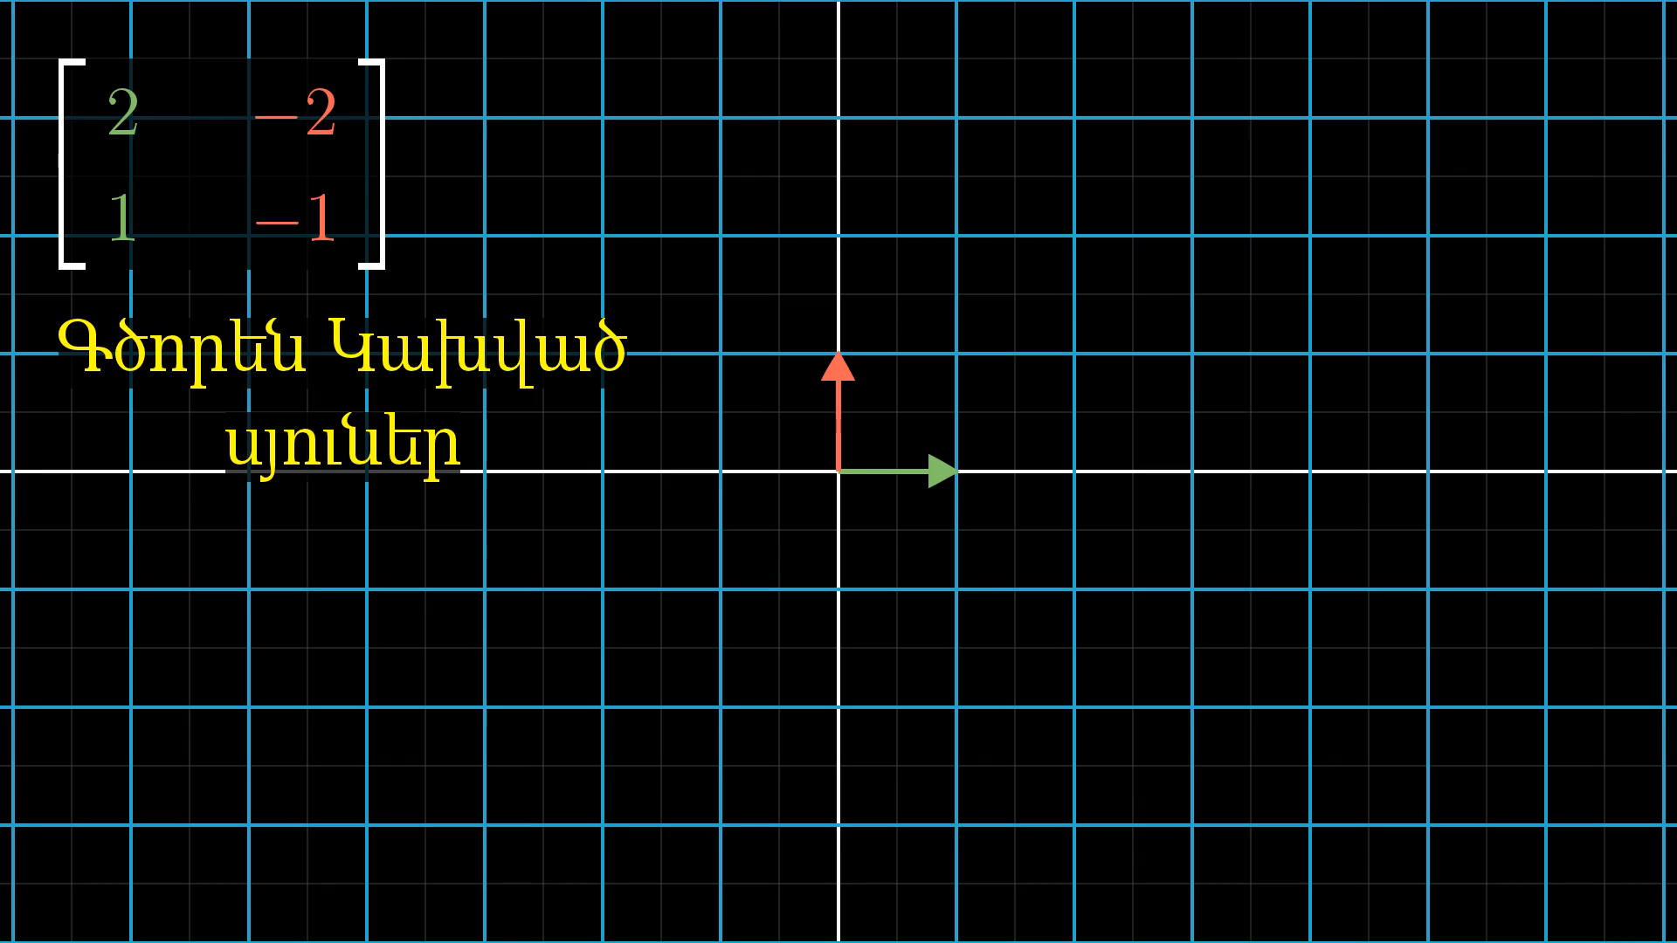
Notes:
Linearly dependent columns

Slide 33
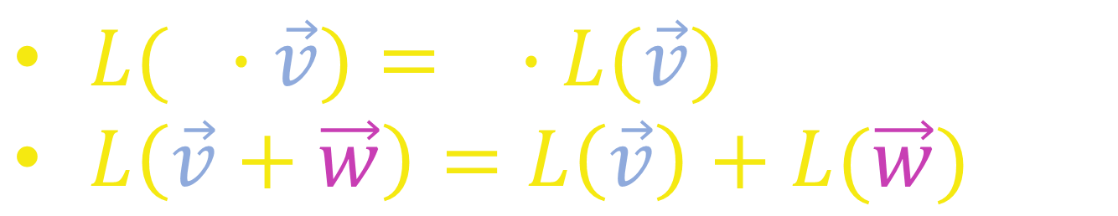
Ավելի ֆորմալ․
Տրանսֆորմացիան կասենք գծային, եթե․
$L(c∙\vec{v})=c∙L(\vec{v})$
$L\left(\vec{v}+\vec{w}\right)=L\left(\vec{v}\right)+L(\vec{w})$

Slide 34
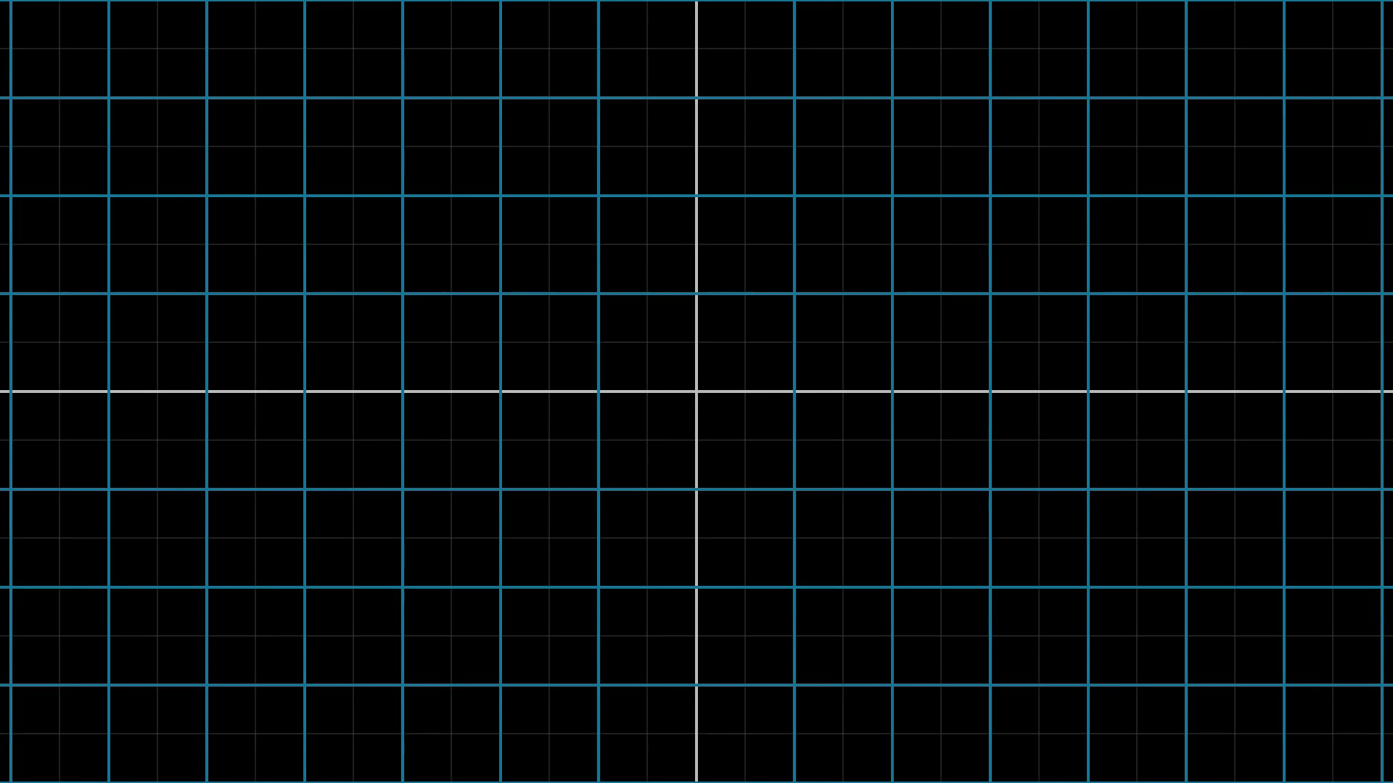
Notes:
Addition property

